Slide 1
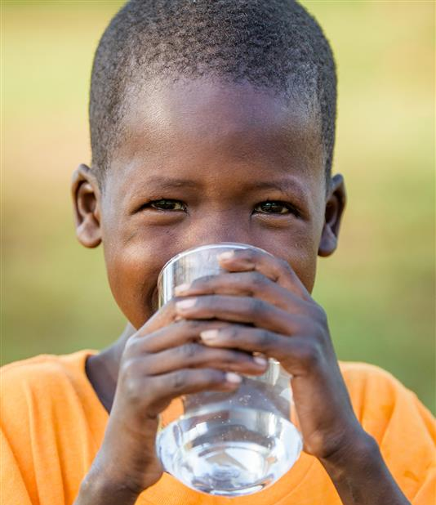
“For I was hungry and you gave me something to eat,
I was thirsty and you gave me something to drink,
I was a stranger and you invited me in,
I needed clothes and you clothed me,
I was sick and you looked after me,
I was in prison and you came to visit me.”
Matthew 25:35-36 (NIV)
Experience poverty, respond by faith

Slide 2
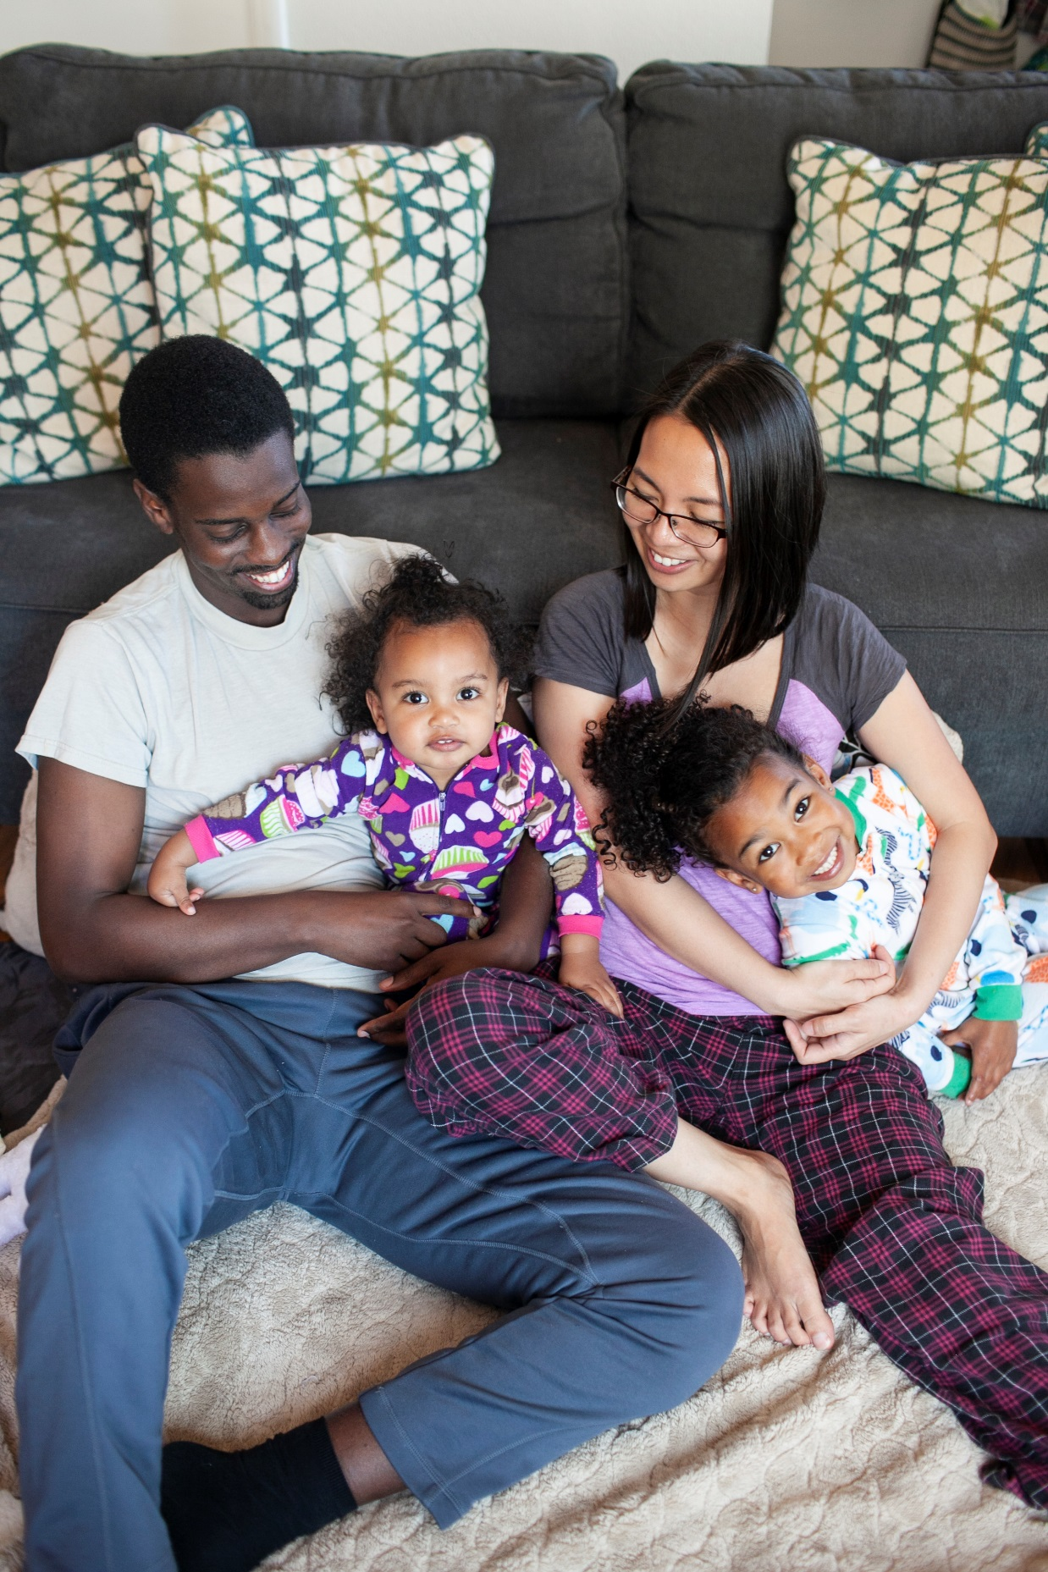
The Matthew 25 Challenge is a week-long challenge that Christians can sign up with their families. Each day, you will take up a new challenge, step out of your comfort zone and engage in what Jesus teaches in Matthew 25: caring for the least among the brothers and sisters, and understanding the needs of those living in poverty.
Period?
During Lent 2021, around Good Friday or any other days chosen by the church
Format
During the challenge, participants will receive a daily challenge every morning for them to experience the hardships of poor children throughout the day. Every night, after completing the daily challenge, they can watch a World Vision sharing video online (~10mins) and pray for the world’s needy together
A pastor or small group leader will serve as a facilitator to forward the “6-Day Challenge Information” by phone to participants every day and remind them to pray every night
Gather on Day 7 to share and pray together. Churches can invite World Vision staff to share a message or introduce activities before/after the challenges

Slide 3
Participants
Facilitators
Day 1
Light Dinner I was hungry
Text participants
every morning:
Challenge Info
Video Link
Reflection
Text participants
every evening:
Reflection
Video Link
Day 2
Water Only I was thirsty
Day 3
Sleep on the Floor I was a stranger
Day 4
Wear the Same Clothes I need clothes
Day 5
Reach Out I was sick… I was in prison
Day 6
Prayer Walk Did it for one of the least
Sunday
Gather, Share, Give and Commit
Encourage, Mobilize
Lifelong mission
Live out Matthew 25, Commit to serving the poor, Sponsor a World Vision child
If your church service is held on Saturday, please start the challenge on the previous Sunday.
Donate the money saved from the Light Dinner on Day 1 to support World Vision’s food security and relief projects in vulnerable regions

